Slide 1
Web Development
BSc Applied Computing / Forensics / Entertainment Systems/ IOT
Eamonn de Leastar (edeleastar@wit.ie)
Dr. Brenda Mullally (bmullally@wit.ie)

Slide 2
Agenda
The Module
The Internet
The Web
The Labs

Slide 3
Agenda
The Module
The Internet
The Web
The Labs

Slide 4
Web Development
Tuition Team:
Eamonn de Leastar (edeleastar@tssg.org)
Dr. Brenda Mullally (bmullally@wit.ie)
12 Week Module
2 Lecture
+1 x 2 hour supervised lab
100% Continuous assessment
2 Assignments during term.

Slide 5
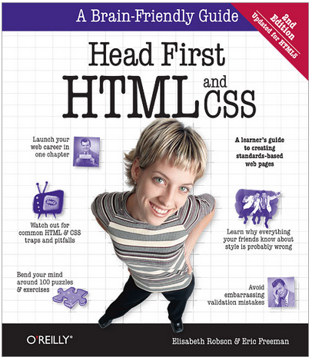
Recommended Text
Head First HTML and CSS, 2nd Edition. By Freeman, Elisabeth and Eric Freeman. 2012. Head First HTML with CSS & XHTML . O'Reilly & Associates. 658 p. ISBN 978-0-596-15990-0
£17 on amazon (new)

Slide 6
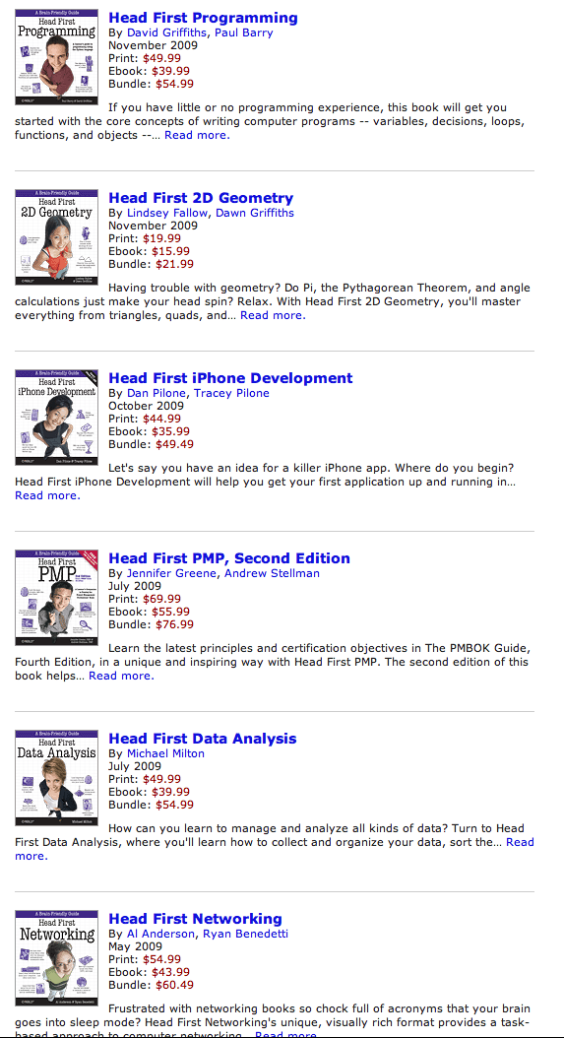
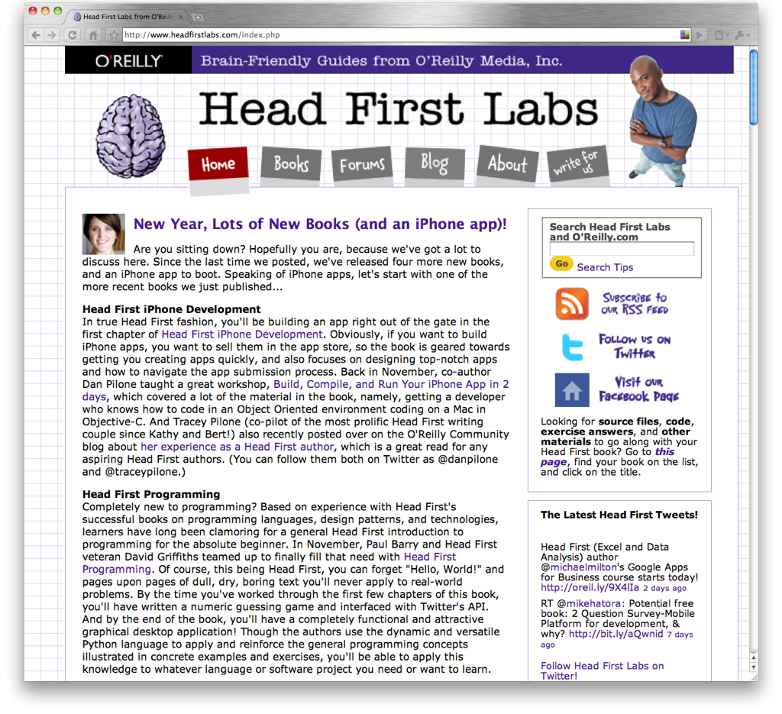

Slide 7
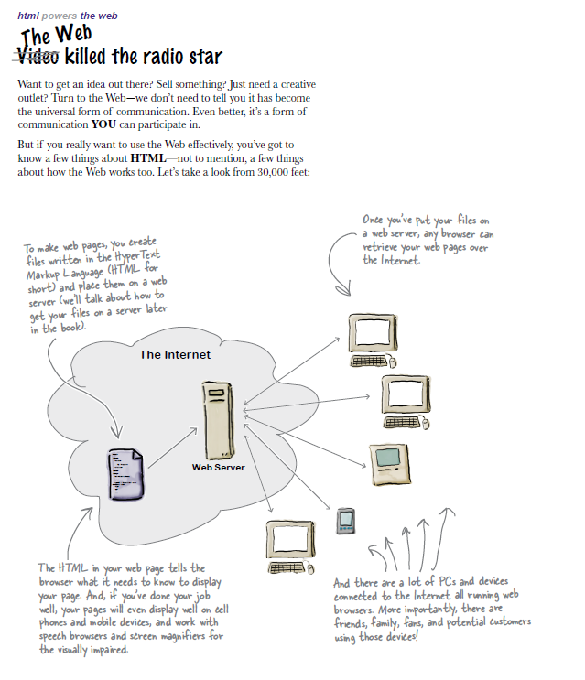

Slide 8
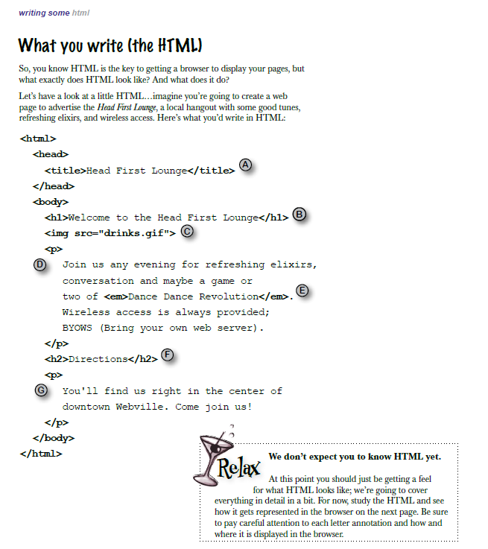
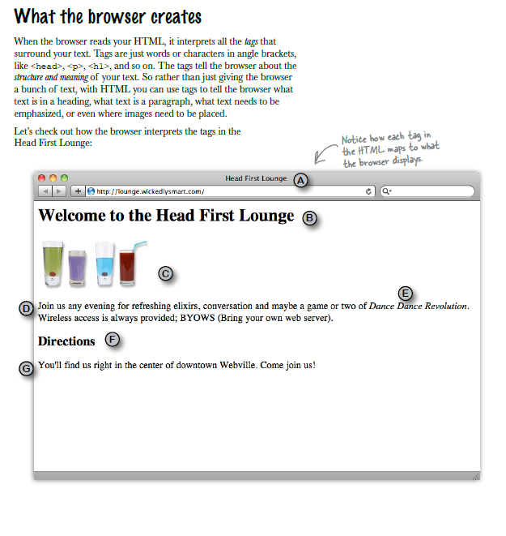

Slide 9
Topics in Web Development
The language of the Web:
Hypertext Markup Language - HTML
Cascading Style Sheets - CSS
... by building over successive labs a simple web site from scratch.
Focus on the structure and meaning of:
CODE - html, css

Slide 10
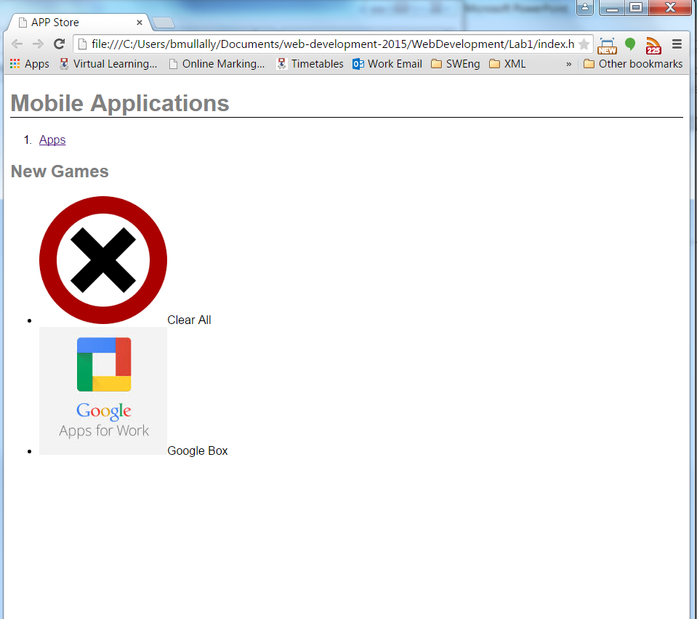
Lab 01
files
documents
folders
directories
media
content
A document rendered (displayed) in a browser

Slide 11
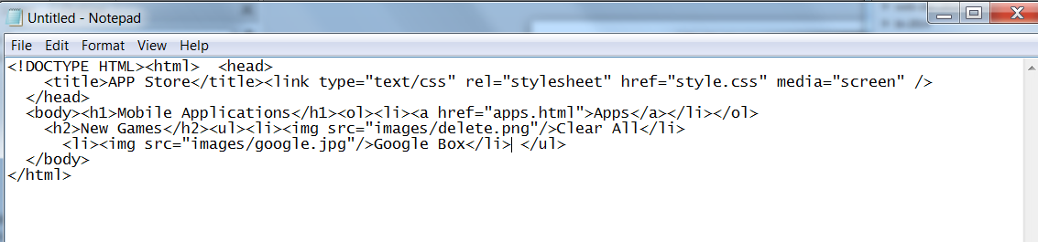
The actual document text - but poorly structured (indented)

Slide 12
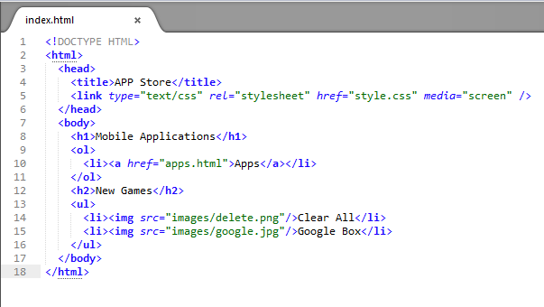
Exactly the same document - pleasingly indented
12

Slide 13
Agenda
The Module
The Internet
The Web
The Labs

Slide 14
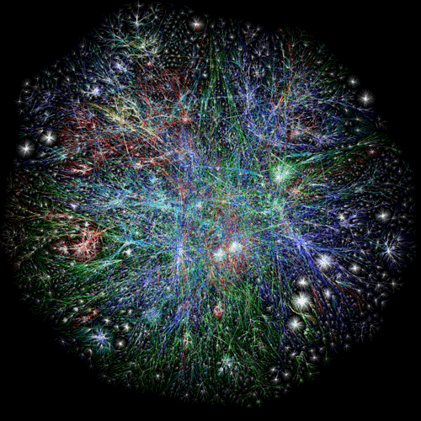
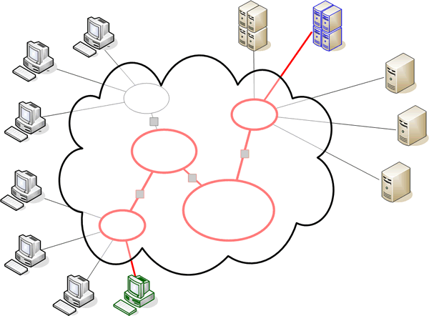
The Internet

Slide 15
The Internet
Global network infrastructure connecting millions of computers.
More than 190 countries linked
3,137,102,200 Internet users (04/06/2015 www.internetlivestats.com)
952,105,920 websites.

Slide 16
Underlying nature of the Internet - Protocols & Standards
Email
SMTP
POP
IMAP
File Transfer
FTP
SFTP
FTP over SSH
Login
Telnet
SSH
Web
HTTP, HTML
Messaging
XMPP
The irony is that in all its various guises -- commerce, research, and surfing -- the Web is already so much a part of our lives that familiarity has clouded our perception of the Web itself.
Tim Berners-Lee in Weaving the Web

Slide 17
Agenda
The Module
The Internet
The Web
The Labs

Slide 18
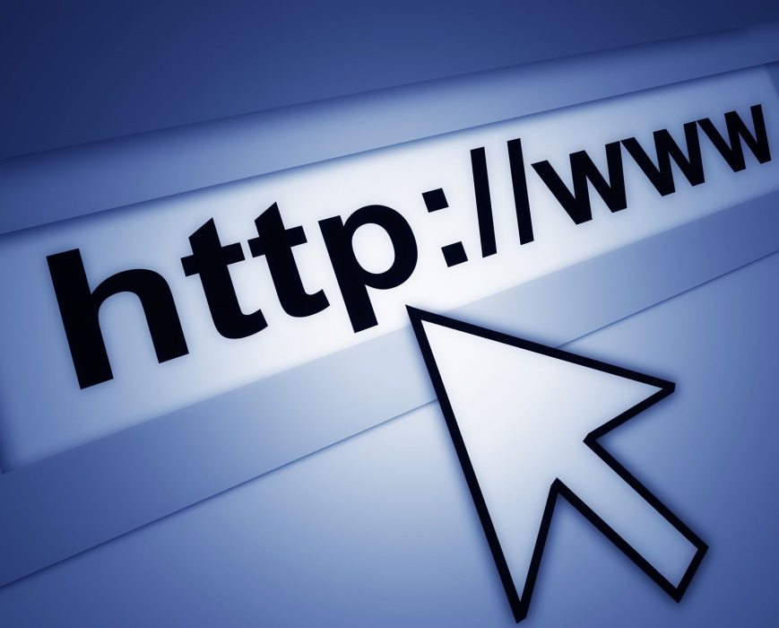
World Wide Web
The world wide web is a huge globally distributed collection of information and data that can be accessed via the internet with the help of of http: Hypertext Transfer Protocol
WWW has made the Internet the most important communication medium of our days.
Thanks to the simple to use graphical interface – The Web Browser – the WWW provides everyone with simple access to information

Slide 19
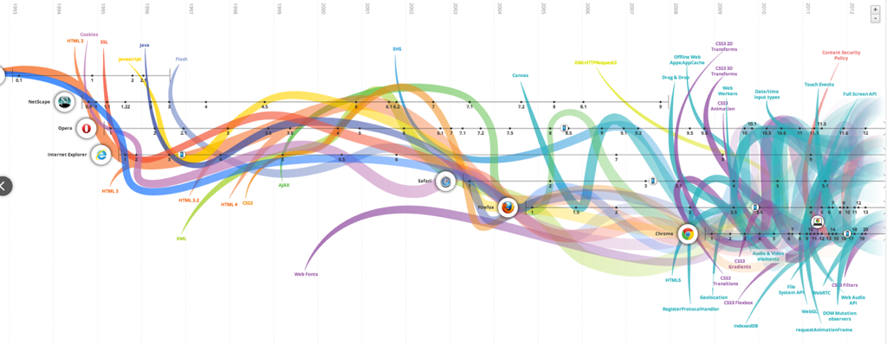
Evolution of the Web - 1990-2012

Slide 20
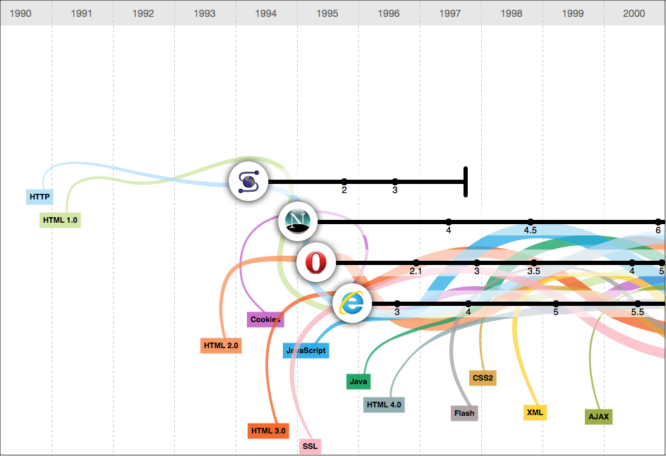
Evolution of the Web - 1990-2000

Slide 21
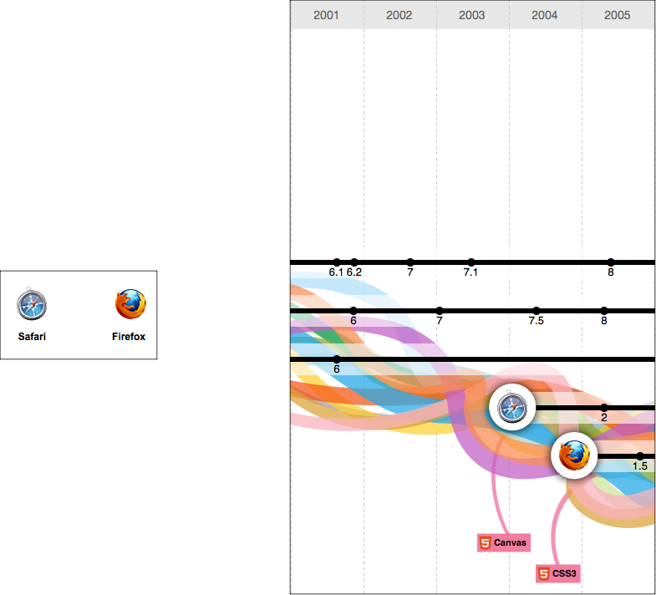
2001-2005

Slide 22
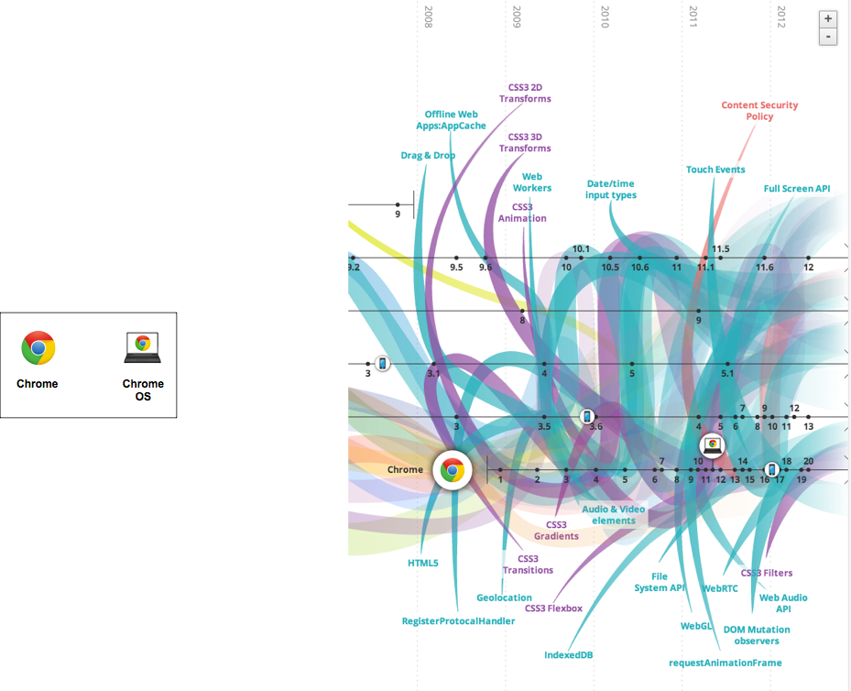
2006-2012

Slide 23
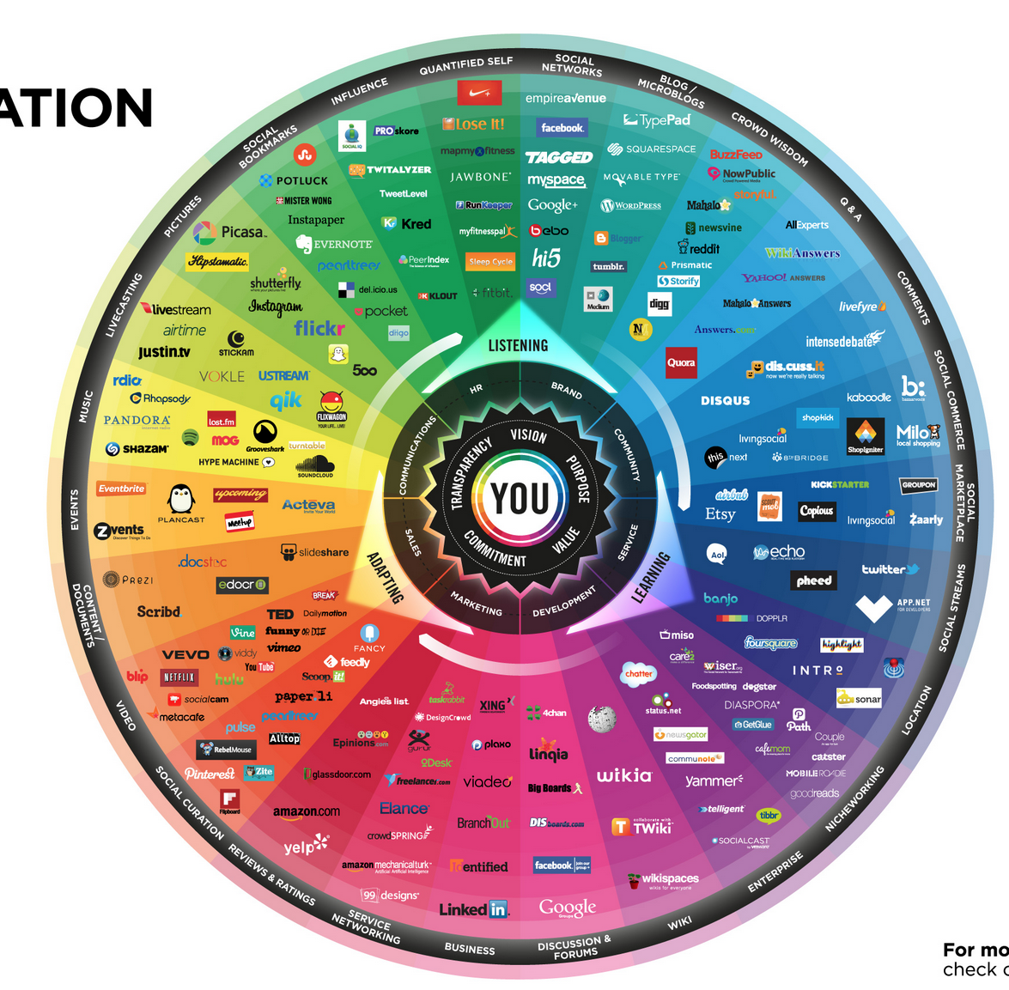
conversationprism.com

Slide 24

Devices

Slide 25
The Web
Protocols & Standards
Protocol : agreed vocabulary to enable two programs to communicate
Standard: an agreed definition of the structure and meaning of a document
Web Protocol
Hyper Text Transfer Protocol - HTTP
Web Standard
Hyper Text Markup Language - HTML
Web Servers and Web Browsers use HTTP to exchange HTML documents

Slide 26

Clients and Servers
Client/Server Computing:
The interaction between two programs when they communicate across a network.
A program at one site sends a request to a program at another site and awaits a response.
The requesting program is called a client; the program satisfying the request is called the server.

Slide 27
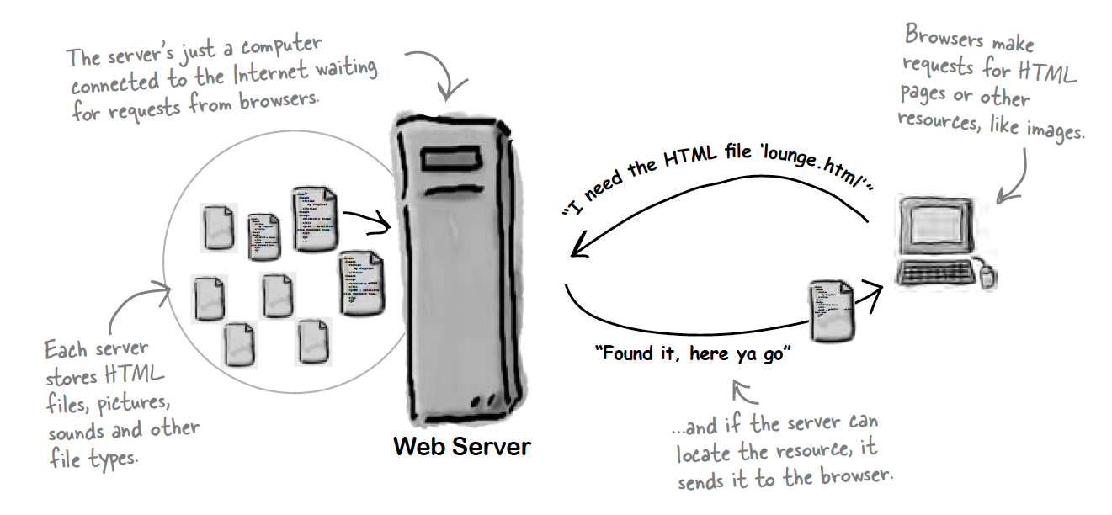
Role of Server

Slide 28
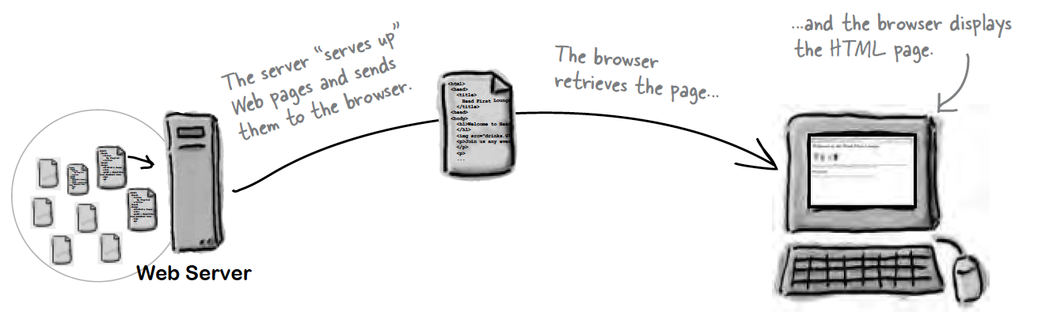
Role of Client

Slide 29
Hyper Text Markup Language
HTML tells your browser about the structure of your document:
where the headings are,
where the paragraphs are,
what text needs emphasis, etc
what text needs to linked
what images to be displayed
Given this information, browsers have built-in default rules for how to display each of these elements.
This information is conveyed using “Tags”, this denote the intention of the author regarding the structure and display of the document.

Slide 30
HTML
An HTML document is called a ‘page’
The starting page of a site is called the ‘homepage’
Markup language should only be used for the description of the document structure and not to describe the document presentation
Every HTML document consists of two parts:
Document ‘header’: contains information about the document.
Document ‘body’: contains the content of the document.

Slide 31
HTML Tags (more correctly called Elements)
Tags for this week
Grouped by purpose:
Structural
<html>, <head>, <title>, <body>
Text
Heading
<h1>, <h2>
Text
<p>, <em>
Hypertext
<a>
Image
<img>
Style
<style>
<html>
<head>
<title>
<body>
<h1>
<h2>
<em>
<a>
<img>
<style>

Slide 32
The Page
A
B
C
D
E

Slide 33
A
E
B
C
D

Slide 34
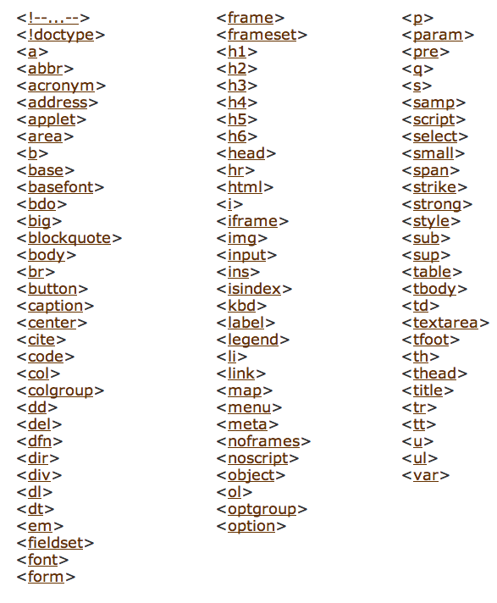
HTML Complete List.

Slide 35
Complete List by Purpose (1)
Structural
body, head, html, title
Text
abbr, acronym, address, blockquote, br, cite, code, dfn, div, em, h1, h2, h3, h4, h5, h6, kbd, p, pre, q, samp, span, strong, var
Heading
h1, h2, h3, h4, h5, h6
Block
address, blockquote, div, p, pre
Inline
abbr, acronym, br, cite, code, dfn, em, kbd, q, samp, span, strong, var
Hypertext
a
List
dl, dt, dd, ol, ul, li
Applet, deprecated.
applet, param
Text Extensions
Presentation
b, big, hr, i, small, sub, sup, tt
Edit
del, ins
Bi-directional text
bdo
Forms
Basic Forms
form, input, label, select, option, textarea
Forms
form, input, select, option, textarea, button, fieldset, label, legend, optgroup

Slide 36
Complete List by Purpose (2)
Tables
Basic Tables
caption, table, td, th, tr
Tables
caption, table, td, th, tr, col, colgroup, tbody, thead, tfoot
Image
img
Client-side Imagemap
area, map
Object
object, param
Frames
frameset, frame, noframes
Iframe
iframe
Metainformation
meta
Script
script, noscript
Style
style
Link
link
Base
base
Legacy, deprecated.
basefont, center, dir, font, isindex, menu, s, strike, u

Slide 37
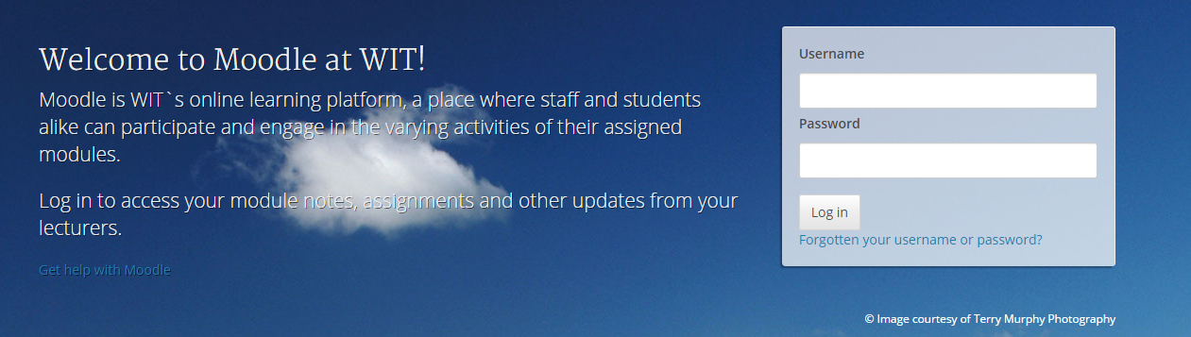
Moodle

Slide 38
Labs Philosophy
Learn by Doing
Supported by reading Associated chapter in Head First HTML (in general, 1 chapter per lab)
Supervised by module team
Do Exercises & Don’t be afraid to experiment - you cant break the web!

Slide 39
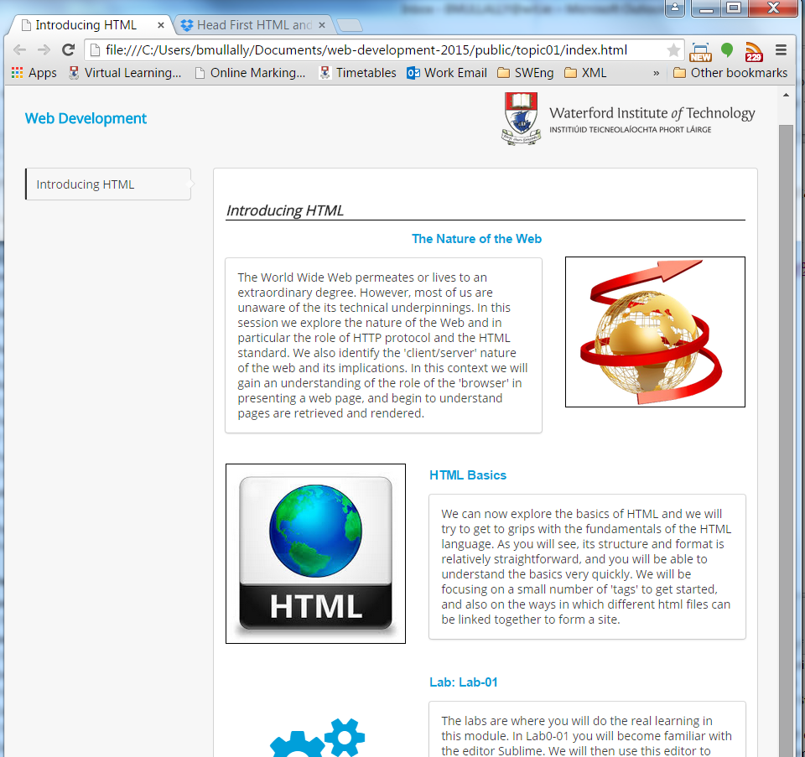
Weekly topic area with links to pdf document for each lecture and a link to the current weekly lab.
39

Slide 40
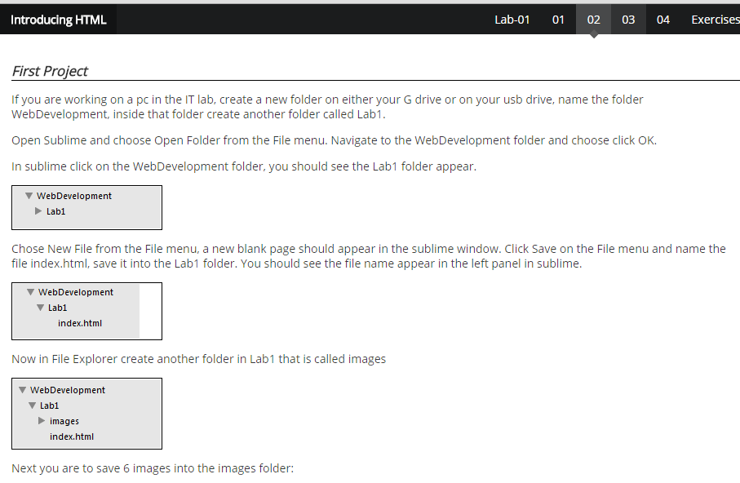
Steps
Instructions for each step

Slide 41
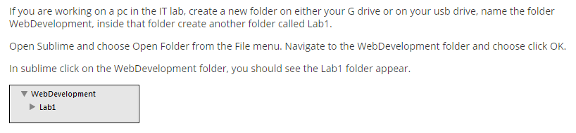
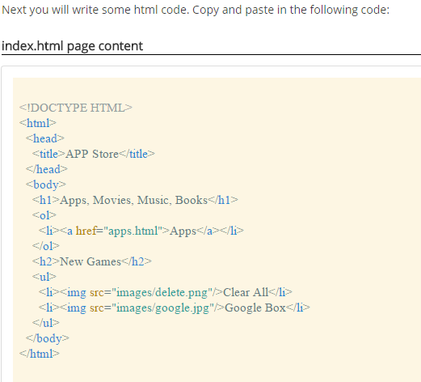
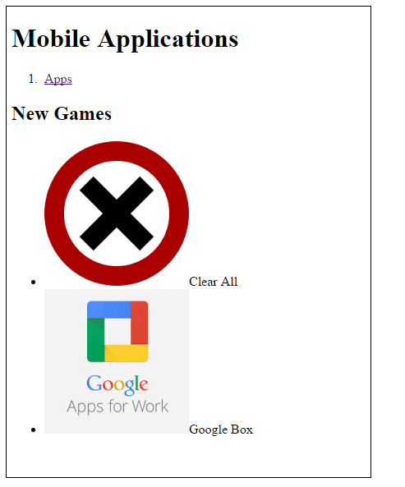
Typical Step:
Short motivation
Screen shots to show outcome
Some html to type
More screen shots to
show expected outcome
Not a race! - Take your time
2 hours timetabled/supervised
Reflect as you go along

Slide 42
Objectives for Lab 01
Be able to download and install Sublime Text 2, and understand its key features.
• Create a WebDevelopment folder to contain a new Lab folder each week.
• Create a simple static web site, and be able to manage it within the Sublime environment
Familiar with the following HTML elements:
<html> <head> <title> <link> <body> <h1> <h2> <p> <a> <img> <ul> and <ol>

Slide 43
Good Luck!

